Slide 1
Cost
Source of most materials:
Xiwei Xu, Ingo Weber, and Mark Staples. Architecture for Blockchain Applications. Springer, 2019

Slide 2
What will you learn today?
On-chain Data Cost
Smart Contract Cost
Cost Models
Using and Evaluating a Cost Model

Slide 3
Cost is important
Monetary cost is as important for blockchain technologies as they are for conventional technologies
Blockchain systems have different cost models
Cost for storing too much data on-chain can explode quickly
Blockchains enable decentralized trust, but bring tradeoffs against execution cost and latency
Cost may be inversely proportional to throughput on blockchain
E.g., on Ethereum: higher gas consumption of a Tx means lower Tx throughput per block / time (if all else is static)
Thus, cost is also relevant for non-public blockchains
Notes:
In software architecture for blockchain-based applications, one of the most critical non-functional properties to consider is cost.
However, blockchain systems have different kind of cost models,
the cost for storing too much data on-chain can explode rather quickly.
We will learn different options for storing data, and the principles of cost for smart contract deployment and execution.
Blockchains enable decentralized trust in storage and execution, but bring tradeoffs against execution cost and latency.

Slide 4
Arbitrary Bytes in Unspendable Bitcoin Tx
Coinbase Transaction in Block
Coinbase transaction mints new coins received by the miner who generates the block
nSequence of a transaction
Distinguish transactions from other Bitcoin transactions
Every participants with the permission to submit transaction can set the value
Coinbase parameter can contain arbitrary data
Presenting assets other than BTCs
Only the miner has access to this parameter
Fake account address
Conditional statements
Sending a small amount of coins to the fake account
The coin is lost forever
Use 1-of-n multi-sig transaction
OP_IF, OP_ELSE, OP_ENDIF
Clauses cannot be reached under any condition
Extra overhead
Minimum amount of funds needed to avoid denial of service attack
Notes:
A common practice for data management in blockchain-based systems is to store raw data off-chain, and to store on-chain just meta-data, small critical data, and hashes of the raw data.
In the Bitcoin blockchain, before OP_RETURN was made a valid opcode to store arbitrary bytes in an unspendable transaction
if the recipient account of the transaction belongs to the owner of the arbitrary data, no coin lost
difficult to parse.
To avoid denial of service attack, Bitcoin sets a minimum amount of funds that can be transferred to an address, so that transactions with outputs below this threshold are discarded by the miners.
smart contracts use conditional statements, such as in Bitcoin’s Script or Ethereum’s EVM. For example, A clause within a conditional statement, which cannot be reached under any condition, can be used to store arbitrary data.

Slide 5
OP_RETURN
Official way to embed arbitrary data in a Bitcoin transaction
Returns immediately with an error
Included data is not interpreted as a script
Default Bitcoin client only relayed OP_RETURN transactions up to 80 bytes
Reduced to 40 bytes in 2014
Storing 80 bytes of arbitrary data on the Bitcoin costs roughly US$0.459
Assuming a typical Bitcoin transaction with one input and one output (220 bytes)
The default transaction fee rate is 2 × 10⁻⁴BTC/KB
It is debatable whether Bitcoin should be used to record arbitrary data.
Exchange rates of US$7650 / BTC from 2 August 2018 (https://poloniex.com/exchange#usdt_btc)
Notes:
All four methods are deprecated
Storing 80 bytes of arbitrary data on the Bitcoin blockchain costs roughly US$0.459142
2 times 10 to the power of minus 4
It is debatable whether Bitcoin should be used to record arbitrary data.

Slide 6
Storing Data in Ethereum Transaction
80 bytes on Bitcoin costs US$0.459
Theoretically allows storing arbitrary data of any size
Practically limited by block gas limit
Storing 80 bytes of arbitrary data on Ethereum costs roughly US$0.22
Every transaction has a fixed cost of 21,000 gas
Gas is the internal pricing for executing a transaction of storing data
Every non-zero byte of data costs additional 68 gas
Total cost of storing 80 bytes via transaction is 26,440 gas
assuming all bytes are non-zero
Exchange rate of US$420 / ETH from 2 August 2018 (https: //poloniex.com/exchange#usdt_eth)
gas price of 2 × 10−9 ETH (2 Gwei) on Ethereum
Notes:
According to the cost model given in the Ethereum yellow paper

Slide 7
Storing Data in Smart Contract
Storing 32 bytes of data
(simple types of Solidity are 32 bytes)
Storing data as a variable in a smart contract
Cost is based on the number of SSTORE operations
1 SSTORE operation that changes the data from zero to non-zero (20,000 gas)
Transaction as the carrier costs a base 21,000 gas
Data payload costs extra gas
Function signature and the actual data
Cost for creating the smart contract depending on its complexity
Total cost is > US$0.036 (20,000 + 21,000 + 32 × 68 gas )
Subsequent transactions to update data costs 5,000 gas (keeping the data as non-zero)
Cost of subsequent transactions is ~ US$0.024 (5000 + 21,000 + 32 × 68 gas)
Less flexible due to the constraints of Solidity on the value types and length
Storing data as a log event in a smart contract
1 log topic costs 375 gas
Every byte of data costs an extra 8 gas
Transaction as the carrier costs a base 21,000 gas
Total cost is ~US$0.018 (21,000 + 375 + 32 × 8 gas)
Notes:
Ethereum provides two other ways to store arbitrary data in smart contracts
We compare the two ways using a a piece of data with 32 bytes. as simple types in Solidity, the script language on Ethereum, are 32 bytes
The cost of storing data in the contract storage is based on the number of SSTORE operations required for the contract variable.
The data payload of the transaction including the function signature and the actual data costs extra gas.
The second option is to store arbitrary data as a log event. This follows different rules for calculating cost.
Storing data as a variable in a smart contract is more efficient to manipulate, but less flexible due to the constraints of the Solidity language on the value types and length.
Using smart contract log events is intermediate because log events allow up to three parameters to be queried.

Slide 8
Smart Contract Cost
Cost charged on transactions in relation to their complexity
Base cost for any transaction (21,000 gas)
Variable components
Data attachments
Contract execution is charged per bytecode instruction
Additional cost for contract deployment
Gas
All cost follows a fixed pricing table specified in the unit gas
Official: Yellow Paper (see Appendix G)
Unofficial table: see here
Gas cost is converted to Ether
User-defined gas price factor
How much Ether-per-gas is the transaction creator willing to pay
Default value is the current market rate, an average over previously included transactions (but do not rely on it without testing)
Notes:
There is a cost charged on Ethereum for transactions in relation to their complexity.
A detailed cost model is presented later
plus variable components: data attachments as discussed above; executing a smart contract method is charged per bytecode instruction; and additional cost arises during deployment of new contracts.

Slide 9
Gas Limit
Block gas limit
Sum of gas used by the set of transactions included in a given block cannot exceed this limit
Set by the miners
Defined in terms of gas usage
Cannot be influenced by variations a normal user has power over
For example, underbidding the market price
Making it a limit of complexity for new blocks
An upper bound to throughput scalability
Cost of transactions vary
Non-trivial to understand how the bound relates to transaction throughput
Current prices & inclusion speeds: https://ethgasstation.info/
Notes:
To prevent denial-of-service attacks, Ethereum has a block gas limit:
Each miner winning a block can slightly increase or decrease the block gas limit, or keep it unchanged.
Because the block gas limit is defined in terms of gas usage, not the transaction fee in Ether, this limit cannot be influenced by variations that the user has power over (such as underbidding the market price)
effectively making it a limit of complexity for new blocks.

Slide 10
Cost Modelling & Estimation
Notes:
In the following slides, we describe models to estimate the cost of running an application on two different types of infrastructures.
Using these models, we investigate the question: What are kinds of cost tradeoffs are there for blockchain vs. cloud?
We use the execution of an instance of a business process model as sample application.
For blockchain infrastructure, we use Ethereum because its smart contracts are in a Turing-complete scripting language which can be used to represent business process logic.
For conventional cloud infrastructure, we use Simple Workflow Service (SWF) from Amazon Web Services, because it is dedicated to process execution and
offered by a leading commercial cloud computing provider.
It can implement the commonly-used workflow patterns, as well as synchronous and asynchronous messaging patterns.

Slide 11
Cost Models
The Cost of Distrust: how much more expensive is using Ethereum over public cloud – operational cost of all components that are needed
Use the execution of an instance of a business process model as sample application
Cost Model of Blockchain Infrastructure (Ethereum)
Turing complete language to implement business logic
Cost Model of Amazon Web Services (Amazon SWF)
Dedicated to process execution
Implements commonly-used workflow patterns and messaging patterns
AWS is a leading commercial cloud computing provider
Notes:
In the following slides, we describe models to estimate the cost of running an application on two different types of infrastructures.
Using these models, we investigate the question: What are kinds of cost tradeoffs are there for blockchain vs. cloud?
We use the execution of an instance of a business process model as sample application.
For blockchain infrastructure, we use Ethereum because its smart contracts are in a Turing-complete scripting language which can be used to represent business process logic.
For conventional cloud infrastructure, we use Simple Workflow Service (SWF) from Amazon Web Services, because it is dedicated to process execution and
offered by a leading commercial cloud computing provider.
It can implement the commonly-used workflow patterns, as well as synchronous and asynchronous messaging patterns.

Slide 12
Cost Models
The Cost of Distrust: how much more expensive is using Ethereum over public cloud – operational cost of all components that are needed
Use the execution of an instance of a business process model as sample application
Cost Model of Blockchain Infrastructure (Ethereum)
Turing complete language to implement business logic
Cost Model of Amazon Web Services (Amazon SWF)
Dedicated to process execution
Implements commonly-used workflow patterns and messaging patterns
AWS is a leading commercial cloud computing provider
Notes:
In the following slides, we describe models to estimate the cost of running an application on two different types of infrastructures.
Using these models, we investigate the question: What are kinds of cost tradeoffs are there for blockchain vs. cloud?
We use the execution of an instance of a business process model as sample application.
For blockchain infrastructure, we use Ethereum because its smart contracts are in a Turing-complete scripting language which can be used to represent business process logic.
For conventional cloud infrastructure, we use Simple Workflow Service (SWF) from Amazon Web Services, because it is dedicated to process execution and
offered by a leading commercial cloud computing provider.
It can implement the commonly-used workflow patterns, as well as synchronous and asynchronous messaging patterns.

Slide 13
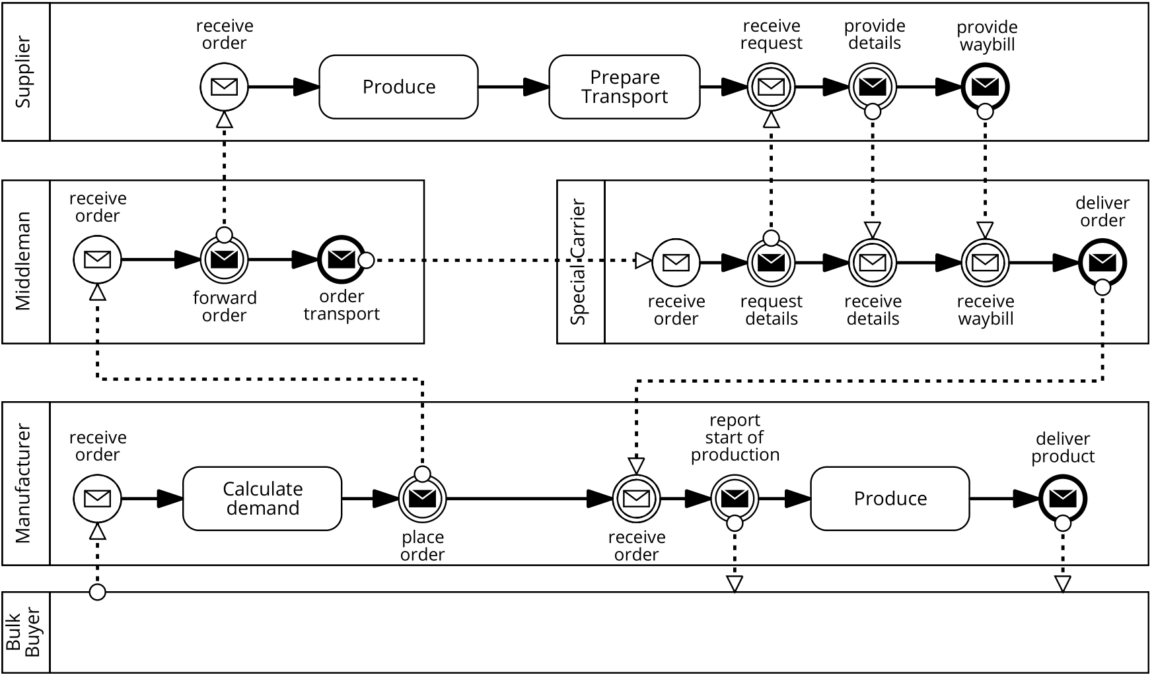
Sample Application: Supply Chain Process
Supply Chain Process as BPMN Collaboration Diagram
Notes:
Supply chain process in BPMN orchestration:
The process starts with a Bulk Buyer placing an order with a Manufacturer.
The latter calculates the demand and places an order for materials via a Middleman.
This Middleman forwards the order to a Supplier and arranges transportation by a Special Carrier.
Once the materials are produced, the Carrier picks them up at the Supplier site and delivers them to the Manufacturer.
The Manufacturer produces the goods and delivers them to the Bulk Buyer.

Slide 14
Sample Application: Supply Chain Process
Supply Chain Process as BPMN Choreography Diagram
Notes:
The choreography model from a global viewpoint and there is no party that sees all messages.
A choreography is a global, participant-independent view of a collaborative process, and focusses on the interaction points between different participants.
This view only vaguely specify what needs to be done by whom, but not how.

Slide 15
Cost Models
The Cost of Distrust: how much more expensive is using Ethereum over public cloud – operational cost of all components that are needed
Use the execution of an instance of a business process model as sample application
Cost Model of Blockchain Infrastructure (Ethereum)
Turing complete language to implement business logic
Cost Model of Amazon Web Services (Amazon SWF)
Dedicated to process execution
Implements commonly-used workflow patterns and messaging patterns
AWS is a leading commercial cloud computing provider
Notes:
In the following slides, we describe models to estimate the cost of running an application on two different types of infrastructures.
Using these models, we investigate the question: What are kinds of cost tradeoffs are there for blockchain vs. cloud?
We use the execution of an instance of a business process model as sample application.
For blockchain infrastructure, we use Ethereum because its smart contracts are in a Turing-complete scripting language which can be used to represent business process logic.
For conventional cloud infrastructure, we use Simple Workflow Service (SWF) from Amazon Web Services, because it is dedicated to process execution and
offered by a leading commercial cloud computing provider.
It can implement the commonly-used workflow patterns, as well as synchronous and asynchronous messaging patterns.

Slide 16
Sample Application using Ethereum
Interaction between internal process implementation, triggers, and process instance smart contract
Sequence Diagram of the First Two Tasks:
Interface component
(1 per party)
Smart contract (1 in total)
Enterprise applications, people, etc.
(out of scope)
Notes:
Interaction between internal process, triggers and process instance smart contract
During process execution, the trigger receives API calls from its owner, as well as to logical messages from the process instance contracts.
When Bulk buyer’s trigger API is called from its owner, the trigger translates the received message into a blockchain transaction, sends the transaction to the instance contract.
The smart contract check conformance to see if the smart is in a state where the message can be sent
Mf’s trigger. When the receives a logical message from the instance contract, it updates its local state and makes an API call to the internal enterprise application that implements the private process for its owner.

Slide 17



Student Task
What components do we have to consider for a cost comparison cloud vs. blockchain in the above context?

Slide 18
Ethereum Transaction 1/2
3 types of transactions
Financial transfer, message call and contract creation
Basic elements: from, to, gasLimit, value and data
Financial transfer transaction
From/to sender/recipient of the transaction
Value the amount transferred
Data (optional) data in arbitrary form
E.g. JSON, XML, pictures, hash values
Fee for a transaction covers the cost for storing the data permanently
Notes:
The fee for a transaction with attached data covers the cost for storing the data permanently in the blockchain
and is proportional to the size of the data

Slide 19
Ethereum Transaction 2/2
Message call transaction
Invoke a function of a contract
From/to sender/recipient of the transaction
Value (optional)
Data the method to be invoked and the parameters
gasLimit maximum gas can be used in this transaction
Gas is paid for each executed bytecode instruction
Contract creation transaction
to NULL
Data the contract bytecode
Value (optional)
Cost of executing business process
Cost of deploying business process
Notes:
the data field carries the method to be invoked and the parameters. The gasLimit is used to specify the maximum gas that can be used in this transaction. Gas is paid for each bytecode instruction that is executed.
a contract creation transaction is indicated by a to value of NULL, and data that contains the contract bytecode.
For both message call and contract creation transactions, the value field is optional.

Slide 20
Contract Creation Cost 1/2
Contract creation transaction
Data compiled bytecode C_{pload} = payload (in bytes) × C_{gas/byte}
Permanent storage incurs cost
Value (optional Ether transfer)
“Endowment” upon initialization
Ethereum address is assigned to it
Calculated with a deterministic function depending only on the creator’s Ethereum account
Cost for contract creation:
C_{create} = C_{tx} + C_{addr} + C_{pload} + C_{fndef}
C_{tx}: 21,000 gas base cost for transaction itself
C_{addr}: 32,000 gas for allocating address
C_{fndef} : consumed by the opcodes in the function definition
Cost of payload for contract bytecode is 200 gas per byte
Cost of payload for data in a financial transaction/message call is 68 gas per non-zero byte and 4 per zero byte
Notes:
We divide our business process blockchain cost model into two parts, one for the cost of deploying a smart contract and one for the cost of executing business process coordination.
A contract creation transaction includes compiled bytecode in the data field, and the permanent storage of this data incurs cost.
An optional ‘endowment’ of gas can be provided, so that the new contract has a positive balance upon initialization. When a contract is created,
a particular Ethereum address is assigned to it, which is subsequently used to interact with that contract.
This contract address is calculated with a deterministic function that depends only on the creator’s Ethereum account.
Additional gas that is consumed by the opcodes in the function definition (Cfndef ).
plus the cost of data payload (Cpload, the size of contract bytecode multiplied by gas per byte)

Slide 21
Contract Creation Cost 2/2
Contract can be created by another contract
Cheaper Without C_{tx}
C_{create}’ = C_{addr} + C_{pload} + C_{fndef}
Notes:
In Ethereum, a contract can create another contract.
This is cheaper because this does not have Ctx.
So, the cost of creating a new contract by an existing contact, Ccreate prime

Slide 22
Contract Execution Cost
Function call cost
C_{execute} = C_{tx} + C_{pload} + C_{fnexe}
C_{tx}: 21,000 base gas for transaction itself
C_{pload}: cost of data payload
C_{fnexe} : consumed by the opcodes executed during the function invocation

Slide 23
Gas Cost → Ether → Another Currency
C$ = C_{Gas} × gasPrice × 10⁻¹⁸ × EXC_{ETH2CUR}
C$ : cost in $
C_{Gas} : cost in gas
Gas price in wei (10⁻¹⁸ Ether)
EXC_{ETH2CUR :} Exchange Exchange
See e.g. https://coinmarketcap.com/currencies/ethereum/ https://fx-rate.net/ETH/USD/
Notes:
The costs calculated with Equations 9.1 to 9.4 are in gas.
In order to convert these costs into Ether, the total gas consumed must be multiplied by the gas price in wei (one wei is 10−18 Ether).
Finally, the cost in Ether can be converted into another currency through an exchange service at some exchange rate, EXCETH2CUR. We specify this in Equation 9.5.

Slide 24
Cost of Interaction Component 1/2
Blockchain
Interface component
Enterprise system
Assuming the interface component is running on AWS
C_{comp} =EC2_{price}(ec2_{t}) × time
EC2_{t} : the set of all available VM types in AWS; ec2_{t} ∈ EC2_{t} is the chosen type
Capacity of VM
TP_{bc} : EC2_{t} → R
Determine VM type needed based on workload WL_{bc}
f_{bc} : (TP_{bc} , WL_{bc}) → EC2_{t}
Cost of running a VM of this type per billing time unit (BTU)
EC2_{price} : EC2_{t} → R
Notes:
Interface component between blockchain and enterprise system
the cost of the VM that acts as an interface between the process and the enterprise systems of participants needs to be considered
To calculate the cost of the interface VM, we need a few more definitions.
Let EC2t be the set of all available VM types in AWS Elastic Compute Cloud (EC2), and ec2t ∈ EC2t .
We define each VM type’s capacity as TP bc : EC2t → IR.
We define a function that determines the VM type based on the coordination workload, WLbc, and VM capacity: fbc : (T Pbc, WLbc) → EC2t.
The cost of running a VM of this type per billing time unit (BTU) is captured as EC2price : EC2t → IR.
We obtain the VM cost by multiplying the price with the number of BTUs it is required to run.

Slide 25
Cost of Interaction Component 2/2
Blockchain
Interface component
Enterprise system
Interface component operates a full node
Synchronize the blockchain if the VM is not constantly online
Required duration includes the time of synchronization
Ethereum clients allows fast synchronization (“fast” flag)
Downloading transaction receipts instead of the full set of known blocks
Shows that the transactions happened but
Does NOT show the results of the smart contract function execution
Less evidence for integrity
Can only be done when downloading the blockchain from scratch
Takes on the order of hours to days for public Ethereum blockchain
Notes:
The interface VM operates a full node.
If the VM is not constantly online, the required duration for this VM needs to include the time to synchronize the blockchain with the network.
This can only be done when downloading the blockchain from scratch and takes on the order of hours to days for the public Ethereum blockchain, depending on the machine and connectivity chosen, and the size of the data structure.

Slide 26
Cost Models
The Cost of Distrust: how much more expensive is using Ethereum over public cloud – operational cost of all components that are needed
Use the execution of an instance of a business process model as sample application
Cost Model of Blockchain Infrastructure (Ethereum)
Turing complete language to implement business logic
Cost Model of Amazon Web Services (Amazon SWF)
Dedicated to process execution
Implements commonly-used workflow patterns and messaging patterns
AWS is a leading commercial cloud computing provider
Notes:
In the following slides, we describe models to estimate the cost of running an application on two different types of infrastructures.
Using these models, we investigate the question: What are kinds of cost tradeoffs are there for blockchain vs. cloud?
We use the execution of an instance of a business process model as sample application.
For blockchain infrastructure, we use Ethereum because its smart contracts are in a Turing-complete scripting language which can be used to represent business process logic.
For conventional cloud infrastructure, we use Simple Workflow Service (SWF) from Amazon Web Services, because it is dedicated to process execution and
offered by a leading commercial cloud computing provider.
It can implement the commonly-used workflow patterns, as well as synchronous and asynchronous messaging patterns.

Slide 27
Student Task
Do you have prior experience with cloud services?
If so: which?

Slide 28
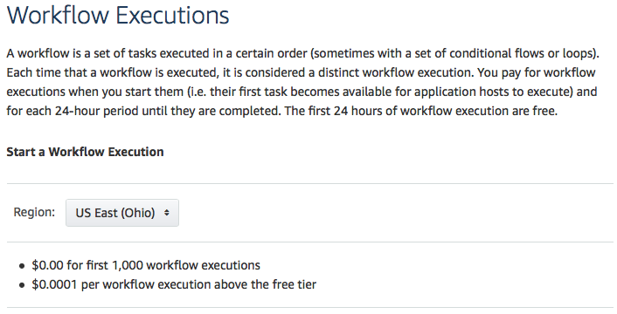
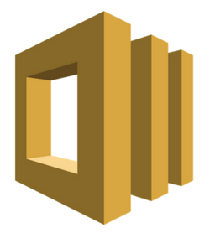
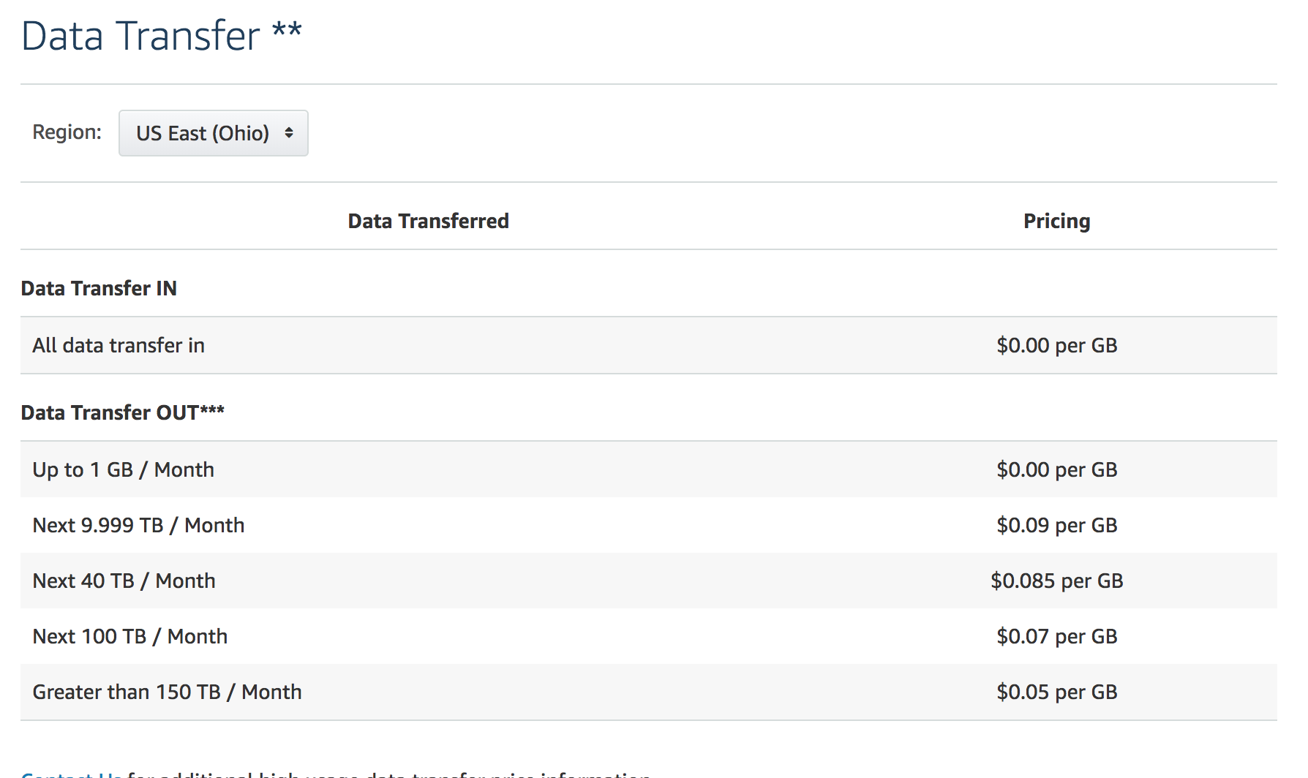
Amazon SWF
Simple Workflow Service (SWF) provided by AWS
Representative for cloud-based business process execution
Clear mapping to the process model
Tiered pricing model
More usage results in cheaper cost per unit
Notes:
AWS provides a service for workflow execution, called Simple Workflow Service (SWF)
We use as a representative for cloud-based business process execution.
We chose SWF as it provides a clear mapping to our process model,
SWF has a tiered pricing model, i.e. more usage will result in cheaper cost per unit.

Slide 29
SWF Cost Model
Main elements: workflow, actor, task, and signal
Workflow: A collection of activities in a specified sequence
An instance of business process
Actor: Play participant roles from the business process.
Activity (task): Schedule a notification to the appropriate actors to proceed with the next activity
Decision (task):
Determine whether the current state of execution conforms to the workflow
Determine which activity to execute next
Signal: External triggered event to a currently executing workflow
Notes:
There are two types of tasks: activity task and decision task.
Anactivity task is used to schedule a notification to the appropriate actors to proceed with the next activity in the workflow execution.
A decision task is used to
A signal is an externally triggered event to a currently executing workflow.

Slide 30
Element Mapping
Business Process | Blockchain | Amazon SWF
Process instance | Instance of Smart Contract | Workflow
Conformance checking | Contract execution (Partial) | Decision task
Activity | Contract execution (Partial) | Activity task
Incoming message | Transaction | Signal
Outgoing message | Entry in contract event log | Notification
Notes:
Mapping between business process elements and blockchain elements and elements in Amazon SWF
Conformance checking is a technique in process mining, which compares an existing process model with an event log produced by the process model.
Conformance checking is used to check if what happened in reality conforms to the process model and can be used at runtime.

Slide 31
Base Cost of Workflow Instances
C_{wf} = #wf × SWFwf
#wf : Number of instances
SWFwf SWF cost of starting a workflow execution
Notes:
The total cost for SWF-based execution has several components.
Base cost for workflow instances Cwf can be calculated by multiplying the number of instances with the SWF cost of starting a workflow execution (SWFwf).

Slide 32
Cost of Scheduling Tasks
C_{task} = ( #actTask + #decTask) × SWF_{task}
#actTask : number of activity tasks
#decTask : number of decision tasks
SWF_{task} : price per task
No. SWF activity tasks = No. activities in a process instance
No. SWF decision tasks = No. activities in a process instance + 1
Notes:
Ctask, is the price per task (SWFtask) multiplied with the sum of activity tasks and decision tasks that are executed.
number of activities in a process instance equals the number of SWF activity tasks
the number of decision tasks is that number plus one additional decision task immediately after the start of the workflow instance
For each process instance, the initialization creates a new workflow (instance) and a decision task to instruct the workflow to wait for the first signal.
For each additional message, the trigger sends one signal which results in one activity task and two decision tasks: the workflow schedules a decision task each time it receives a signal or a completion message from an activity task.

Slide 33
Cost of Signals
C_{sig} = #signals × SWF_{signal}
#signals : number of signals
SWF_{signal} : price per signal
Notes:
The number of signals can be obtained from the number of activities in a business process instance.
calculate the cost of signals, Csig, by multiplying the number of signals with the price per signal,

Slide 34
Cost of Data Retention and Transfer
C_{ret} = ( execT + retT ) × SWF_{ret}
C_{dat} = payload × SWF_{data}
retT: user-specified duration for generated data being retained
Charged for storage per 24 hours
execT : Workflow execution time
Charged per 24 hours at the same rat as data retention cost
SWF_{ret} : SWF cost rate
Payload: inwards and outwards data size
SWF_{data} : price per data unit
Notes:
Data generated during the workflow execution is retained by SWF for a user-specified duration after completion of workflow execution (retT) and is charged for storage per 24 hours.
The workflow execution time (execT) is also charged per 24 hours at the same rate as data retention cost (SWFret).
Cost of data transferred, Cdat, inwards and outwards during the workflow execution, is the total payload data size (payload) multiplied with the cost per data unit (SWFdata)

Slide 35
Coordination Cost
C_{swf} = C_{wf} + C_{task} + C_{sig} + C_{ret} + C_{dat}
Notes:
Coordination cost Cswf is the sum of cost of workflow plus cost of task plus cost of signature plus cost of data retain plus cost of data transfer

Slide 36
Cost of Interaction Component 1/2
Using Amazon SWF
Task execution requires actor running a Amazon SWF worker module
On AWS EC2 or internal infrastructure
Execute both decision task and activity task
Notes:
Similarly as in blockchain, every actor involved in the business process implements its own trigger, which is a program that interacts with Amazon SWF through AWS API calls.
When a trigger’s API is called by its owner, the trigger translates the message into an Amazon SWF signal.
SWF then schedules a decision task to evaluate the signal’s content and to perform conformance checking.
If successful, an activity task is scheduled to notify the actor of the next business activity, manufacturer.

Slide 37
Cost of Interaction Component 2/2
Cost of VMs
Triggers and Amazon SWF workers
Throughput per VM type
TP_{swf} : EC2_{t} → IR
VM type depends on capacity of VM types and the workload
The throughput values are different from the ones for blockchain triggers
f_{swf} : (TP_{swf}, WL_{swf}) → EC2_{t}
Cost of running the VMs for the time needed
C_{comp} = EC2_{price}(ec2_{t}) × time
Minimum requirement is one VM to host the trigger and worker
Preferable setup is that each participant at least one VM
Host their own trigger and worker
Notes:
the coordination cost when using SWF services and does not include the cost of the VMs to run the triggers and the Amazon SWF workers.
In order to calculate the cost for the VMs, we first need to determine the VM type required for a specific workload, WLsw f .
For that we again define the throughput per VM type as T Pswf : EC2t → IR.
The throughput values here are different from the ones for blockchain triggers, due to the different modules that are running for SWF.
we determine the required VM type based on the capacity of VM types and the workload: fswf :(TPswf,WLswf) →EC2t.
We use that information to calculate the cost for running the VMs for the time needed
The minimum requirement is one VM to host the trigger and worker, with the caveat that all participants trust this VM. In a preferable setup, each participant involved provisions at least one VM to host their own trigger and worker.

Slide 38
Evaluating Cost Models
Incident Management Process
9 tasks
6 gateways
4 conforming traces
Cross-organizational
First-level support outsourced
Notes:
Incident management process in BPMN cerography notation. Might go to different levels.
Choreography diagrams are new in BPMN 2.0 and focus on between-processes interactions and message flows.
Another way to look at Choreography is to view it as a type of business 'contract' between two or more organizations.
Every task is an interaction between two parties.
The process starts from a VIP customer come crosses a problem and describe the problem to the key account manager
If the key account manger cannot handle, it ask the 1st level support.
If the 1st level support cannot solve the problem, ask 2nd level support

Slide 39
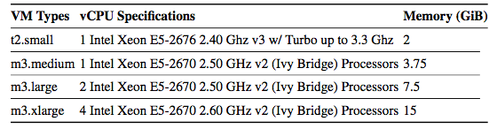
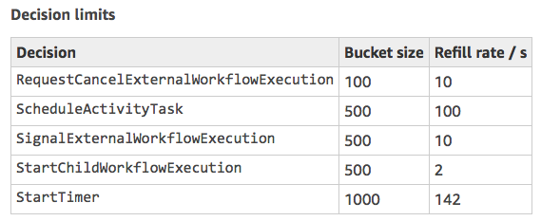
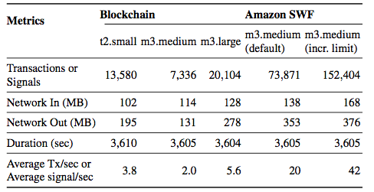
AWS VM Throughput Benchmark
AWS EC2 VM types and specification
Throughput
Notes:
To avoid denial of service attack, Amazon throttle their API call if it is called too often. There is a limit on the AWS SWF API as well.
We can request a limit increase for AWS resources.

Slide 40
Incident Management Blockchain Cost
32 process instances with a total 256 transactions
Deployment of factory contract costs 0.032 Ether (one-time cost）
Each run with data transformation costs 0.0347 Ether
Total cost is approx. US$1.34 per instance
Exchange rate of US$420 / ETH
Gas price of 2 Gwei

Slide 41
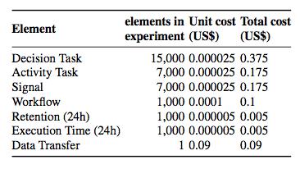
Incident Management Amazon SWF Cost
EC2 t2.micro VM for trigger and SWF task worker
Process instances executed in sequence
US$0.92 for 1,000 process instances
US$0.000925 per instance
Data retention for 1 day
US$0.002745 per instance
Data retention for 365 days
Cost breakdown
Notes:
We deployed an EC2 t2.micro VM for the trigger and the Amazon SWF task worker and executed process instances in sequence.
If the signal frequency during the execution of a workflow instance is too high, AWS may schedule the next decision task to handle the decision logic for all the received messages in a batch. SWF would thus allocate a single decision task to handle multiple signals for a single workflow instance at once, which could distort our results. To prevent SWF from batch processing the signals for a single workflow instance, we send messages synchronously: once the result has been received, we send the next message for that instance.
For the Incident Management process with 1,000 process instances, the total cost for the experiment was US$0.925,
resulting in an average cost of US$0.000925 per process instance.
If we increased the data retention to 365 days, the cost per process instance would be US$0.002745
The data transfer volume for Incident Management was 358 MB, which is rounded up to 1GB.

Slide 42
Comparison
Process instance on blockchain is three orders of magnitude higher than on Amazon SWF
Excluding the one-time factory contract deployment
Blockchain stores the result in perpetuity
As long as the blockchain is in existence
Ongoing cost for data storage on Amazon SWF
Store for 243,863 days (approx. 668 years) to reach break-even (with a rate of US$420 / ETH)
Notes:
Excluding the one-time factory contract deployment,
the cost per process instance on blockchain is currently three orders of magnitude higher than on Amazon SWF.
Blockchain stores the result in perpetuity (as long as the blockchain is in existence)
To put the higher one-time cost for executing a process instance on Ethereum into perspective with the ongoing cost for data storage on Amazon SWF:
to reach break-even, the data would have to be stored for 243,863 days or approx. 668 years.

Slide 43
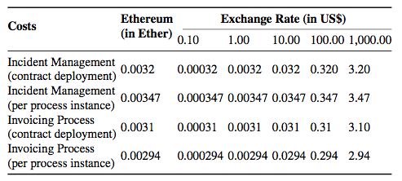
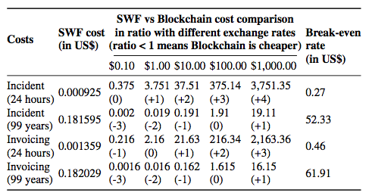
Volatility of Cryptocurrency
Sensitivity to the volatility of the exchange rate
Comparison
Exchange rate
Retention rate (how long the data is stored)
Notes:
The results of our comparative analysis are sensitive to the volatility of the exchange rate from cryptocurrency (Ether in our case) to fiat currency (US$ in our case).
In order to illustrate this, consider a sensitivity analysis where we set the exchange rates for Ether to US$ in scale from US$0.1 to US$1,000.
Another parameter we can vary is the retention rate, where we calculate for the cost of 24 hour and 99 years (long-term) data retention.
Predicted costs of business process execution for Incident Management processes on Ethereum blockchain in this parameter space.
Positive numeric values in the brackets signify order of magnitude higher more expensive on Blockchain.

Slide 44
Why Blockchain
Blockchain provides trustworthy storage and execution environment
No trust in any single third-party
Conventionally participants need to jointly agree on a mutually-trusted third party
E.g. AWS (for confidentiality and truthful execution)
The party controlling the Amazon SWF account
Public blockchain supports payment and escrow
Sending cryptocurrency with existing messages would not incur additional cost
…due to a flat fee structure
Offset the premium cost of distrust
Commercial escrow service charge 0.5% to 3.25%
Lower the cost of process executions involving monetary transaction
Only possible if acceptable crypto-coin can be established or used
Co-opetition
Organizations may cooperate for some cases to achieve business goals
…but compete in other cases
Notes:
We have seen that blockchain costs orders of magnitude more than cloud services for realistic uses for business process execution.
So why should anyone use a blockchain for this?
The key difference is that blockchain technology can provide a trustworthy storage and execution environment, without requiring trust in any single third-party organization.
In the SWF setup, participants need to trust both AWS (for confidentiality and truthful execution) and the party controlling the Amazon SWF account in which the process is hosted.
This is of particular interest in situations of coopetition, where organizations cooperate for specific cases where achieving some business goals is mutually beneficial, but compete in other cases.
In our age of globalization, high market pressure, diversified organizations, and complex business networks, coopetition is a common situation.
If multiple parties come together to achieve a joint goal, but some are in coopetition, it is important that the entity executing the joint business process is neutral.
Public blockchains inherently supports payments and escrow handling. Due to a flat fee structure in blockchains, sending cryptocurrency along with existing messages would not incur any additional cost.
This can offset the premium cost of distrust offered by blockchain. Commercial escrow services often charge 0.5% to 3.25%.
Depending on exchange rates and amounts to put into escrow, blockchain’s flat fees may actually lower the cost of process executions involving monetary transaction despite the additional cost of smart contract execution and data storage.

Slide 45
Student Task
Say, a process instance on Ethereum costs us 0.32$, and on AWS approx. 0.001$, and a commercial escrow provide charges 3% of the value held in escrow
How much money do you have to put into escrow to reach cost equilibrium (same cost) between cloud and blockchain?

Slide 46
Cost vs. Maintainability
Deployment methods impact cost and non-functional properties
(1) One smart contract with two functions
(2) Two smaller contracts, each implementing one function
One contract acts as an entry point
The first has lower deployment cost
For (2), one needs to pay C_{tx} and C_{adr} twice
The payload of contracts in (2) is higher, as there are header bytes in the payload
(1) is cheaper but is not as maintainable as (2)
One function needs to be modified
(1): updated contract needs to be redeployed as a whole
(2): only one contract is redeployed
(1): the triggers need to be updated with the new address
(2): might be avoided
Notes:
Different contract deployment methods impact cost and other non-functional properties. To illustrate this, we set out two sample configurations
Both these configurations provide the same functionality,
intuitively the function definition costs should be the same.
first configuration will have lower deployment cost, even in terms of payload cost, than the second configuration. This is due to several reasons:
For (2), one has to pay Ctx and Cadr twice.
The tradeoff is between cost and maintainability
Redeployment of a contract means getting a new address for the updated contract.

Slide 47
Scaling Triggers
Additional resources are needed to accommodate increasing workload
Vertical scaling (bigger VM)
Horizontal scaling (more VMs)
Blockchain nodes can scale vertically
Horizontal scaling has complication
Easy to add additional VMs into the network
Using one account from multiple VMs may lead to double-spending or sync issues
On Ethereum, nonces need to be unique and sequential
Using different accounts on different VMs
Maintainability issues and increase storage costs
SWF can scale both horizontally and vertically
Vertical scaling by choosing larger VM
Horizontal scaling by adding new VMs
SWF then acts as load balancer
Notes:
Blockchain nodes can scale vertically in order to accommodate increasing workload.
SWF can scale both horizontally and vertically.
Vertical scaling is straight forward in SWF by choosing larger VM configurations.
Horizontal scaling requires launching a new VM and registering it with SWF.
SWF then acts as load balancer, distributing requests to multiple VMs.

Slide 48
Summary
Cost of basic compute and storage on public blockchain have different cost structure than conventional cloud
Orders of magnitude more expensive
Public Ethereum and Amazon SWF are compared using business process execution
Construct and benchmark cost model for both infrastructures
Cost on public Ethereum blockchain is three orders of magnitude higher than on Amazon SWF
Cost model incorporates exchange rate
Important given the high volatility of the exchange rate
Cost is often in tradeoff with other non-functional properties
Maintainability and Scalability

Slide 49
Cost
Source of most materials:
Xiwei Xu, Ingo Weber, and Mark Staples. Architecture for Blockchain Applications. Springer, 2019

